Slide 1
Advanced Encryption Standard (AES)
Lecture slides adopted from “Cryptography and Network Security” by W. Stallings

Slide 2
Origins
Replacement for DES needed
in 1997 on Internet in a few months
in 1998 on dedicated h/w (EFF) in a few days
in 1999 above combined in 22hrs!
US NIST (National Standard and Technology) issued call for ciphers in 1997
15 candidates accepted in Jun 98 (1st round of evaluation)
5 were shortlisted in Aug-99 (2nd round of evaluation)
Rijndael was selected as proposed algorithm in Oct-2000 → AES
Issued as FIPS (Federal Information Processing Standards) PUB 197 standard in Nov-2001
Publicly announced standards developed by the United States federal government for use in computer systems by non-military government agencies and government contractors.
Notes:
The Advanced Encryption Standard (AES) was published by NIST (National Institute of Standards and Technology) in 2001. AES is a symmetric block cipher that is intended to replace DES as the approved standard for a wide range of applications. The AES cipher (& other candidates) form the latest generation of block ciphers, and now we see a significant increase in the block size - from the old standard of 64-bits up to 128-bits; and keys from 128 to 256-bits. In part this has been driven by the public demonstrations of exhaustive key searches of DES.
Whilst triple-DES is regarded as secure and well understood, it is slow, especially in s/w. In a first round of evaluation, 15 proposed algorithms were accepted. A second round narrowed the field to 5 algorithms. NIST completed its evaluation process and published a final standard (FIPS PUB 197) in November of 2001. NIST selected Rijndael as the proposed AES algorithm. The two researchers who developed and submitted Rijndael for the AES are both cryptographers from Belgium: Dr. Joan Daemen and Dr.Vincent Rijmen.

Slide 3
AES Requirements
Private key symmetric block cipher
128-bit data, 128/192/256-bit keys
Stronger & faster (than Triple-DES)
Provide full specification & design details
Both C & Java implementations
Notes:
Special Attention Required
Listed above are NIST’s requirements for the AES candidate submissions. These criteria span the range of concerns for the practical application of modern symmetric block ciphers.

Slide 4
AES Evaluation Criteria
Initial criteria:
security – effort for practical cryptanalysis
cost – in terms of computational efficiency
algorithm & implementation characteristics
Final criteria
general security
ease of software & hardware implementation
implementation attacks, example:-
Timing analysis (TA) : execution time
Power analysis (PA) : power consumption
flexibility (in en/decrypt, keying, other factors)
Notes:
In fact, two set of criteria evolved. When NIST issued its original request for candidate algorithm nominations in 1997, the request stated that candidate algorithms would be compared based on the factors shown in Stallings Table5.1, which were used to evaluate field of 15 candidates to select shortlist of 5. These had categories of security, cost, and algorithm & implementation characteristics.
The final criteria evolved during the evaluation process, and were used to select Rijndael from that short-list, and more details are given in Stallings Table 5.2, with categories of: general security, ease of software & hardware implementation, implementation attacks, & flexibility (in en/decrypt, keying, other factors).

Slide 5
AES Shortlist
Shortlisted in Aug-99 for further analysis & comment
MARS (IBM) - complex, fast, high security margin
RC6 (USA) - v. simple, v. fast, low security margin
Rijndael (Belgium) - clean, fast, good security margin
Serpent (Euro) - slow, clean, v. high security margin
Twofish (USA) - complex, v. fast, high security margin
Contrast between algorithms
few complex rounds vs. many simple rounds
refined existing ciphers vs. new proposals
Came down to the best balance of attributes to meet criteria, in particular the balance between speed, security & flexibility
Notes:
The AES shortlist of 5 ciphers was as shown. Note mix of commercial (MARS, RC6, Twofish) verses academic (Rijndael, Serpent) proposals, sourced from various countries.
All were thought to be good – it came down to the best balance of attributes to meet criteria, in particular the balance between speed, security & flexibility.

Slide 6
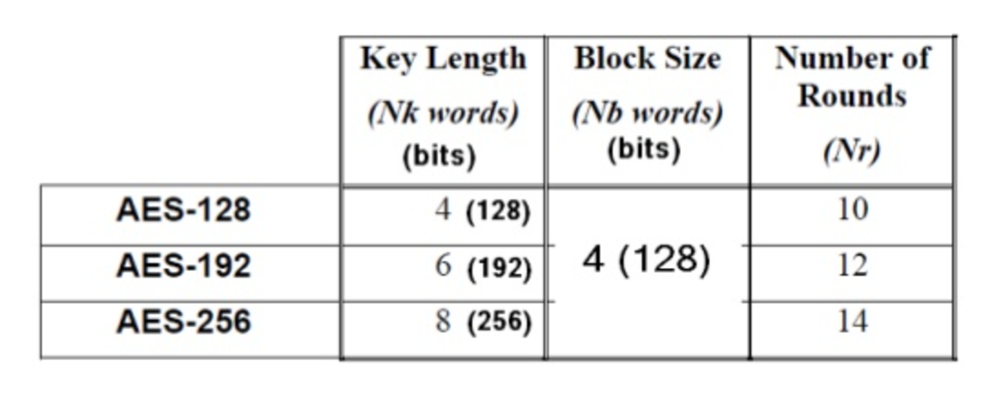
The AES Cipher - Rijndael
Designed by Rijmen-Daemen in Belgium
Design considerations :
Resistant against known attacks
Speed and code compactness on many CPUs
Design simplicity
AES variants, key length and round
⬆ key size = ⬆rounds = ⬆ CPU time
Based on entire data block in every round
Notes:
The Rijndael proposal for AES defined a cipher in which the block length and the key length can be independently specified to be 128,192,or 256 bits. The AES specification uses the same three key size alternatives but limits the block length to 128 bits. Rijndael is an academic submission, based on the earlier Square cipher, from Belgium academics Dr Joan Daemen and Dr Vincent Rijmen. It is an iterative cipher (operates on entire data block in every round) rather than feistel (operate on halves at a time), and was designed to have characteristics of: Resistance against all known attacks, Speed and code compactness on a wide range of platforms, & Design simplicity.

Slide 7
Rijndael Features
A block cipher processing 16 Bytes at a time
Based on iterative substitution permutation network cipher
State is defined as the intermediate cipher result of the data block in AES (4 x 4 bytes-table)
Typical Operations include:-
Key Expansions
Initial Round
Rounds:
SubBytes, ShiftRows, MixColumns, AddRoundKey
Final round consisted of :
SubBytes, ShiftRows, AddRoundKey
4x4 bytes table
Notes:
The input to the AES encryption and decryption algorithms is a single 128-bit block, depicted in FIPS PUB 197, as a square matrix of bytes .This block is copied into the State array, which is modified at each stage of encryption or decryption. After the final stage, State is copied to an output.
The key is expanded into 44/52/60 lots of 32-bit words (see later), with 4 used in each round.
The data computation then consists of an “add round key” step, then 9/11/13 rounds with all 4 steps, and a final 10th/12th/14th step of byte subs + mix cols + add round key. This can be viewed as alternating XOR key & scramble data bytes operations. All of the steps are easily reversed, and can be efficiently implemented using XOR’s & table lookups.

Slide 8
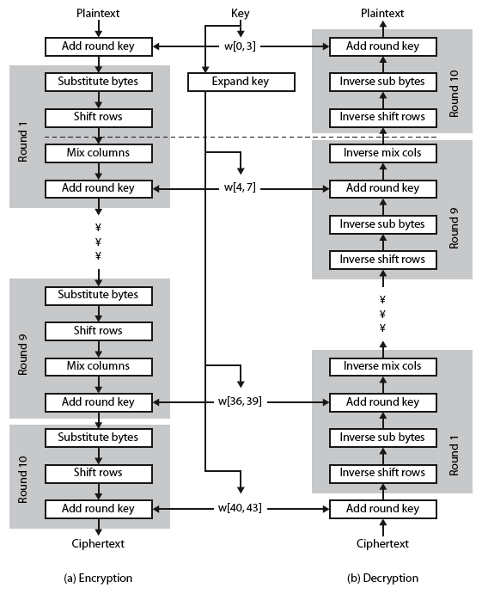
Rijndael
A typical example of AES encryption process with 128 bits of key and 10 rounds of processing
Notes:
Stallings Figure 5.1 shows the overall structure of AES, as detailed on the previous slide.

Slide 9
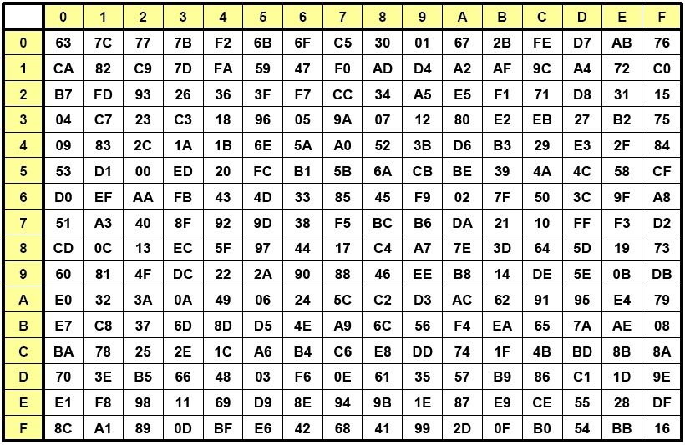
Byte Substitution
A simple substitution of each byte
Substitution table of 16x16 bytes (all permutation of 8-bit values)
Each byte (of the state) is used as the index of the S-box, it is replaced by content from S-box
By row (left 4-bits)
By column (right 4-bits) – (See next slide)
In decryption, Inverse S-box is used
Rijndael S-box is constructed using defined transformation of values in Galois Field(2⁸)
https://captanu.wordpress.com
https://www.slideshare.net
Galois Field or Finite Field contains a finite number of elements (2⁸ or 265 elements)
Notes:
Now discuss each of the four stages used in AES.
The Substitute bytes stage uses an S-box to perform a byte-by-byte substitution of the block.
There is a single 8-bit wide S-box used on every byte.
This S-box is a permutation of all 256 8-bit values, constructed using a transformation which treats the values as polynomials in GF(2⁸) –
IN AES the S-box values are fixed, so really only need to know the table when implementing.
Decryption requires the inverse of the table. These tables are given in Stallings Table 4.5.
The table was designed to be resistant to known cryptanalytic attacks. Specifically, the Rijndael developers sought a design that has a low correlation between input bits and output bits, with the property that the output cannot be described as a simple mathematical function of the input, with no fixed points and no “opposite fixed points”.

Slide 10
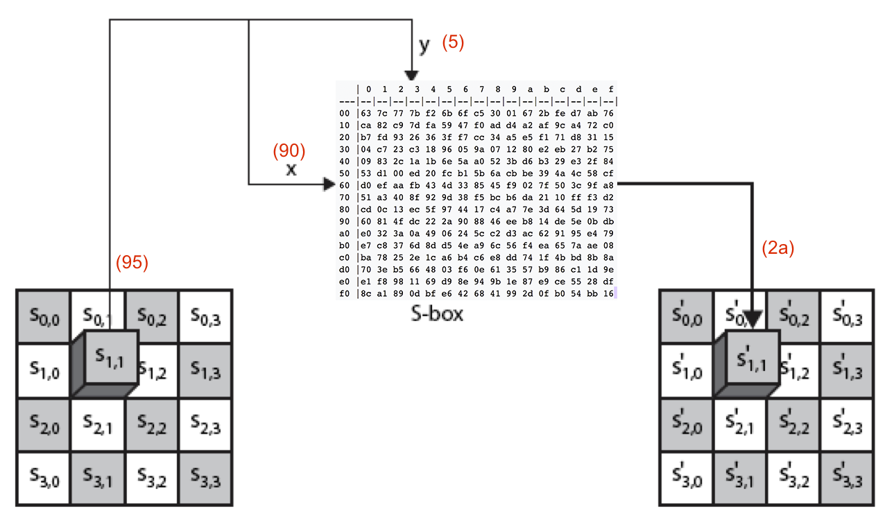
Byte Substitution (Cont)
Notes:
As this diagram from Stallings Fig 5.4a shows, the Byte Substitution operates on each byte of state independently, with the input byte used to index a row/col in the table to retrieve the substituted value.

Slide 11
Shift Rows
Since state is processed by columns, this step permutes bytes between the columns
Circular byte shift in each row
1st row is unchanged
2nd row does 1 byte circular shift to left
3rd row does 2 byte circular shift to left
4th row does 3 byte circular shift to left
Decrypt inverts using shifts to right
Notes:
The ShiftRows stage provides a simple “permutation” of the data, whereas the other steps involve substitutions. Further, since the state is treated as a block of columns, it is this step which provides for diffusion of values between columns. It performs a circular rotate on each row of 0, 1, 2 & 3 places for respective rows. When decrypting it performs the circular shifts in the opposite direction for each row. This row shift moves an individual byte from one column to another, which is a linear distance of a multiple of 4 bytes, and ensures that the 4 bytes of one column are spread out to four different columns.

Slide 12
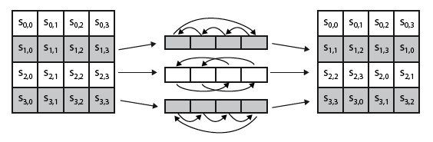
Shift Rows (Cont)
Circular byte shift in each row
1st row is unchanged
2nd row does 1 byte circular shift to left
3rd row does 2 byte circular shift to left
4th row does 3 byte circular shift to left
Notes:
Stalling Figure 5.5a illustrates the Shift Rows permutation.

Slide 13
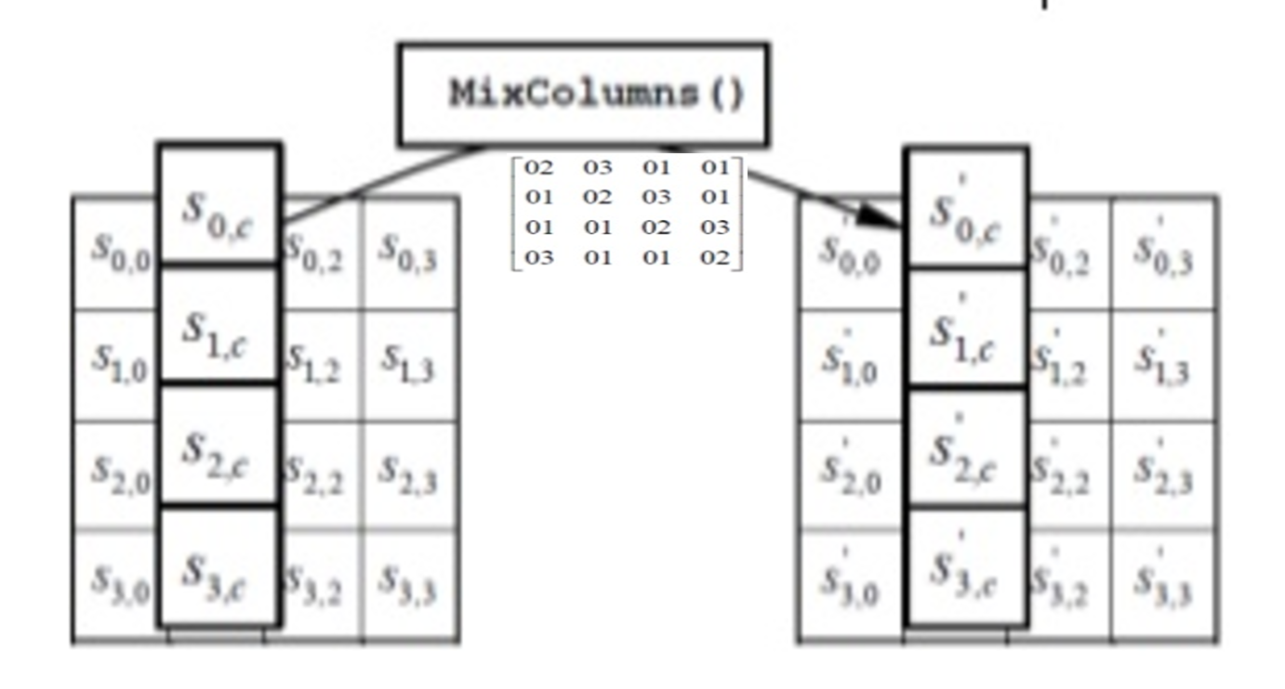
Mix Columns
Each column is processed separately (S → S’)
The MixColumns function multiplies each column (state) with a 4 x 4 byte matrix
Modified from : http://www.slideshare.net/oliynykov/aes-effecitve-software-implementation Slide 14
Notes:
The MixColumns stage is a substitution that makes use of arithmetic over GF(2^8). Each byte of a column is mapped into a new value that is a function of all four bytes in that column. It is designed as a matrix multiplication where each byte is treated as a polynomial in GF(2⁸). The inverse used for decryption involves a different set of constants.
The constants used are based on a linear code with maximal distance between code words – this gives good mixing of the bytes within each column. Combined with the “shift rows” step provides good avalanche, so that within a few rounds, all output bits depend on all input bits.

Slide 14
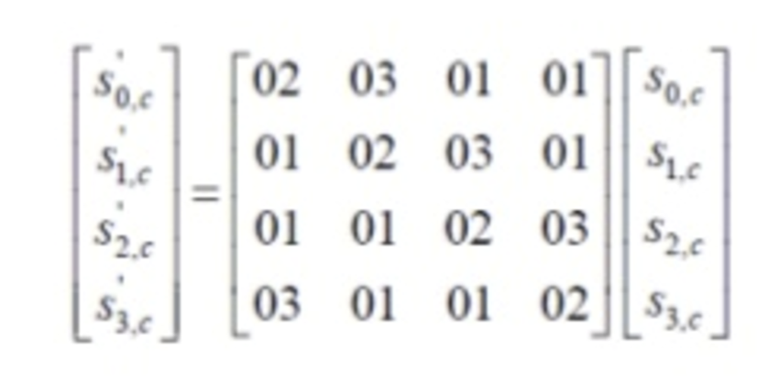
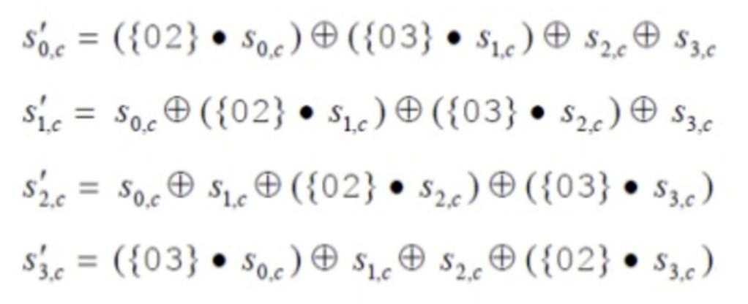
Mix Columns (Cont)
Each byte is replaced by a value dependent on all 4 bytes in the column
[S_{0,c}..S_{3,c} ] x [row 1 of the matrix] = S’_{0,c}
[S_{0,c}..S_{3,c} ] is used 4 times to get S’_{0,c} …S’_{3,c} (using different rows)
Image src : http://www.slideshare.net/oliynykov/aes-effecitve-software-implementation Slide 14
Notes:
Do explain how the martrix multiplication works (Sum of Row * column values)

Slide 15
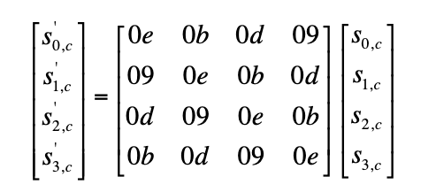
Mix Columns (Cont)
Improved efficiency by using Galois Field GF(2⁸)
Multiplication with matrix
Requires SHIFT and XOR operations only (vs. matrix multiplication)
Decryption requires use of the inverse matrix
Notes:
GF can speedup Mix Column operation by SHIFT and XOR operations (not the full Matrix Multiplication)
For the details on how the GF works check this video (Not tested in exams)
https://www.youtube.com/watch?v=dN2pJRLRcb0 or Read FIPS PUB 197

Slide 16
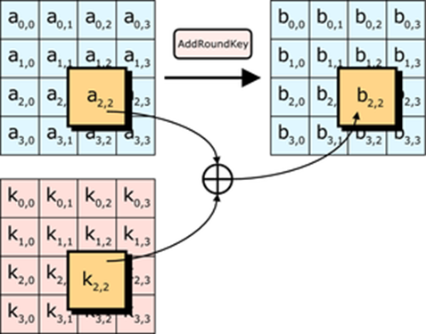
Add Round Key
XOR state with 128-bits of the round key
Processed by column (though effectively a series of byte operations)
Decryption is identical
With reversed keys applied, it will reverse the effect of the XOR during encryption.
Designed to be as simple as possible
Notes:
a form of Vernam cipher on expanded key
Lastly is the Add Round Key stage which is a simple bitwise XOR of the current block with a portion of the expanded key. Note this is the only step which makes use of the key and obscures the result, hence MUST be used at start and end of each round, since otherwise could undo effect of other steps. But the other steps provide confusion/diffusion/non-linearity. That us you can look at the cipher as a series of XOR with key then scramble/permute block repeated. This is efficient and highly secure it is believed.

Slide 17
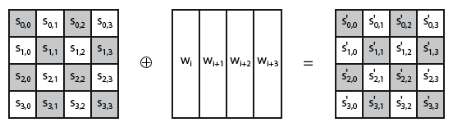
Add Round Key (Cont)
Round keys operates on each byte of state independently.
Notes:
Stallings Figure 5.4b illustrates the Add Round Key stage, which like Byte Substitution, operates on each byte of state independently.

Slide 18
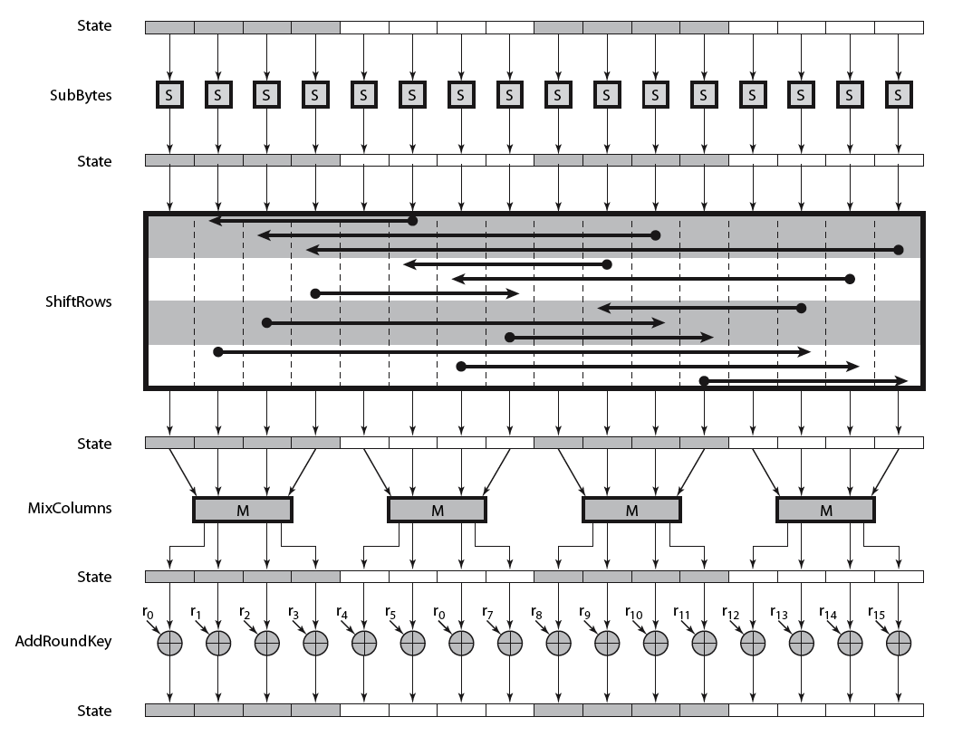
AES Round (zoom out view)
Notes:
Can thus now view all the internal details of the AES round, showing how each byte of the state is manipulated, as shown in Stallings Figure 5.3.

Slide 19
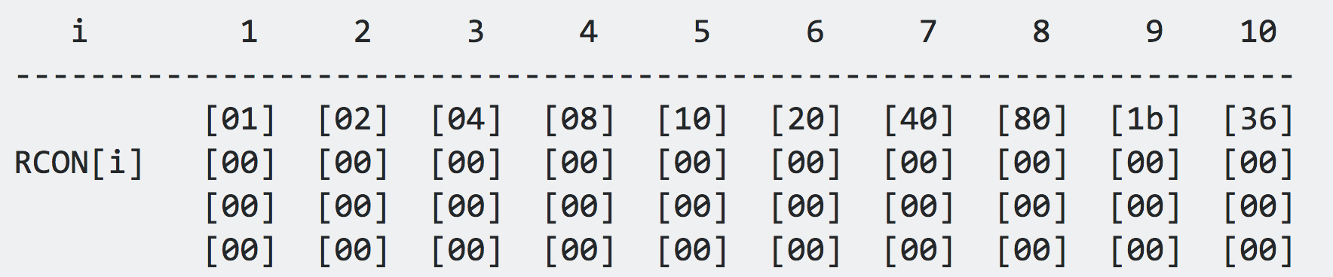
AES Key Expansion
Takes 128-bit key (16-byte) and expands into array of 44(10 rounds) x 32-bit words (W-in each columns)
Uses Round constants (RCON) to increase randomness
Notes:
The AES key expansion algorithm takes as input a 4-word (16-byte) key and produces a linear array of words, providing a 4-word round key for the initial AddRoundKey stage and each of the 10/12/14 rounds of the cipher.

Slide 20
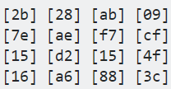


AES Key Expansion (Cont)
Typical operations
Generate First Word
RotBytes
SubBytes using S-box
XOR with W₀ and RCON
W₀
W₁
W₂
W₃
1
Round keys are first copied from the Cipher key (W0 –W3)
2
3
Perform a RotBytes
“09” is rotated to the bottom
→
W₀
W₄
4
5
1st
W
O
R
D
SubBytes using S-box
→
→
XOR
XOR
→
RCON
Notes:
The AES key expansion algorithm takes as input a 4-word (16-byte) key and produces a linear array of words, providing a 4-word round key for the initial AddRoundKey stage and each of the 10/12/14 rounds of the cipher.

Slide 21
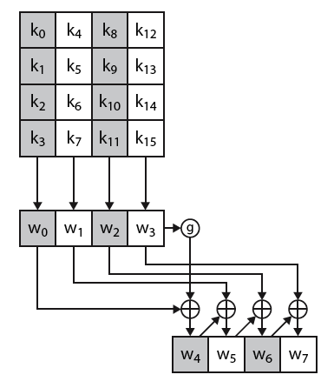
AES Key Expansion (Cont)
W₅₋₇ is generated from previous word XOR with the word in the previous round (W₁₋₃)
W₈ will have the same treatment (Rotate Byte/S-Box/XOR operations) as W₃
The process continue…
Notes:
Stallings Figure 5.6.
It shows each group of 4 bytes in the key being assigned to the first 4 words, then the calculation of the next 4 words based on the values of the previous 4 words, which is repeated enough times to create all the necessary subkey information.
It involves copying the key into the first group of 4 words, and then constructing subsequent groups of 4 based on the values of the previous & 4th back words. The first word in each group of 4 gets “special treatment” with rotate + S-box + XOR constant on the previous word before XOR’ing the one from 4 back. In the 256-bit key/14 round version, there’s also an extra step on the middle word.

Slide 22
Key Expansion Rationale
Designed to resist known attacks
Additional design criteria
knowing part key insufficient to find many more
invertible transformation
if the function f applied to an input x gives a result of y, then applying its inverse function g to y gives the result x, and vice versa.
fast on wide range of CPU’s
use round constants (RCON) to break symmetry
diffuse key bits into round keys
enough non-linearity to hinder analysis
simplicity of description
Notes:
The Rijndael developers designed the expansion key algorithm to be resistant to known cryptanalytic attacks. It is designed to be simple to implement, but by using round constants break symmetries, and make it much harder to deduce other key bits if just some are known (but once have as many consecutive bits as are in key, can then easily recreate the full expansion). The design criteria used are listed above.

Slide 23
AES Decryption
AES decryption is the reverse of encryption
Inverse cipher with steps as for encryption
but using inverses of each step
with a different key schedule
No lost of information
swap byte substitution & shift rows
swap mix columns & add (tweaked) round key
Notes:
The AES decryption cipher is not identical to the encryption cipher (Stallings Figure 5.1). The sequence of transformations for decryption differs from that for encryption, although the form of the key schedules for encryption and decryption is the same. This has the disadvantage that two separate software or firmware modules are needed for applications that require both encryption and decryption. There is, however, an equivalent version of the decryption algorithm that has the same structure as the encryption algorithm, with the same sequence of transformations as the encryption algorithm (with transformations replaced by their inverses). To achieve this equivalence,a change in key schedule is needed.
By constructing an equivalent inverse cipher with steps in same order as for encryption, we can derive a more efficient implementation. Clearly swapping the byte substitutions and shift rows has no effect, since work just on bytes. Swapping the mix columns and add round key steps requires the inverse mix columns step be applied to the round keys first – this makes the decryption key schedule a little more complex with this construction, but allows the use of same h/w or s/w for the data en/decrypt computation.

Slide 24
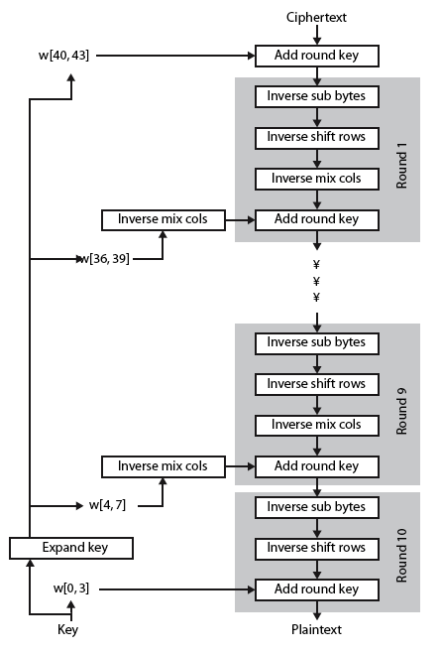
AES Decryption (overview)
Notes:
Illustrate the equivalent inverse cipher with Stallings Figure 5.7.

Slide 25
AES Implementation
Efficient on 8-bit CPU
byte substitution, the smallest substation table required is only 256 entries (for each byte of data)
shift rows is simple byte shift
add round key works on byte XOR’s
mix columns requires matrix multiplication
If there is sufficient memory, the process could effectively be converted to a table lookups.
Notes:
AES can be implemented very efficiently on an 8-bit processor.
AddRoundKey is a bytewise XOR operation.
ShiftRows is a simple byte shifting operation.
SubBytes operates at the byte level and only requires a lookup of a 256 byte table S.
MixColumns (matrix multiply) can be implemented as byte XOR’s & table lookups with a 2nd 256 byte table .

Slide 26
AES Implementation (Cont)
Very efficient on 32-bit CPU
Need to redefine steps to use 32-bit words
Can pre-compute 4 tables of 256-words
Each column in each round can be computed using 4 table lookups + 4 XORs
Cost , memory required, of pre-compute tables : 4Kb
Trade off between speed and storage required
Notes:
AES can also be very efficiently implemented on an 32-bit processor, by rewriting the stage transformation to use 4 table lookups & 4 XOR’s per column of state. These tables can be computed in advance using the formulae shown in the text, and need 4Kb to store.
The developers of Rijndael believe that this compact, efficient implementation was probably one of the most important factors in the selection of Rijndael for AES.

Slide 27
Summary
AES selection process
Details of Rijndael – the AES cipher
Steps in encryption / decryption
Key expansion
Implementation aspects
Notes:
Chapter 5 summary.
https://engineering.purdue.edu/kak/compsec/NewLectures/Lecture8.pdf
http://crypto.stackexchange.com/questions/2418/how-to-use-rcon-in-key-expansion-of-128-bit-advanced-encryption-standard
http://www.slideshare.net/oliynykov/aes-effecitve-software-implementation

